Slide 1
Contest.io:
Online Contests &
Live Voting
Presentation on Mock UI
1705072 • Sourov Jajodia
1705080 • Shafayat Hossain Majumder
1705081 • Md. Kamrujjaman

Slide 2
Overview
Home Page
Contests
Search Contests
User Profile
Notifications
Account Settings
My Contests
Contest Creation
Contest Edit
Contest Details
Voting
Contestant Content Management
Contest Creator Functionality

Slide 3
Home Page

Slide 4
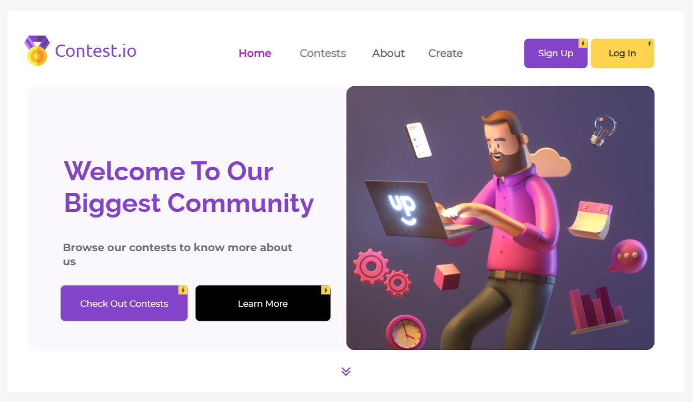
Home Page
(Pre Login)
Menu Bar
Login & Signup Options
Contests Page
About Page

Slide 5
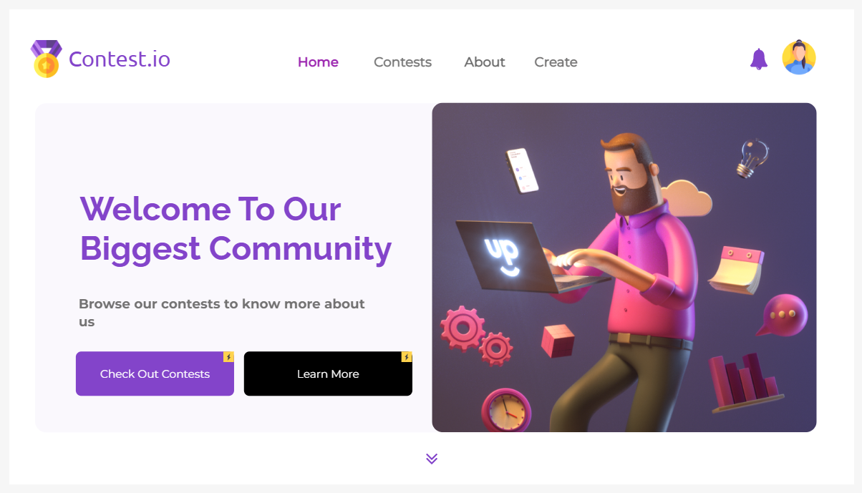
Home Page
(Post Login)
Notifications
User Profile Page & Other Options

Slide 6
Contests

Slide 7
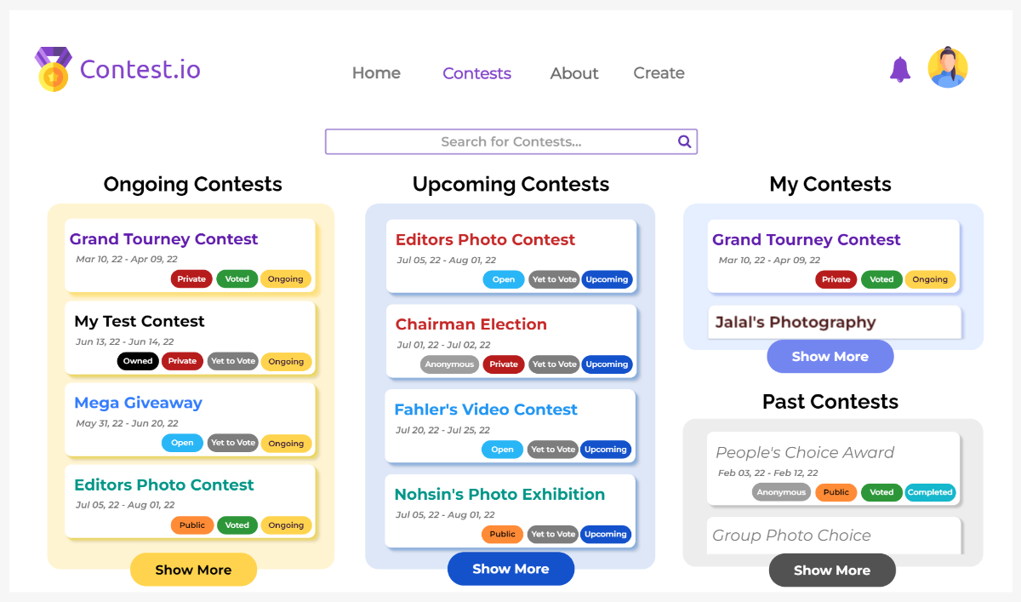
Contests Page
Search Bar

Slide 8
Contests Page
Search Bar

Slide 9
Search Contests

Slide 10
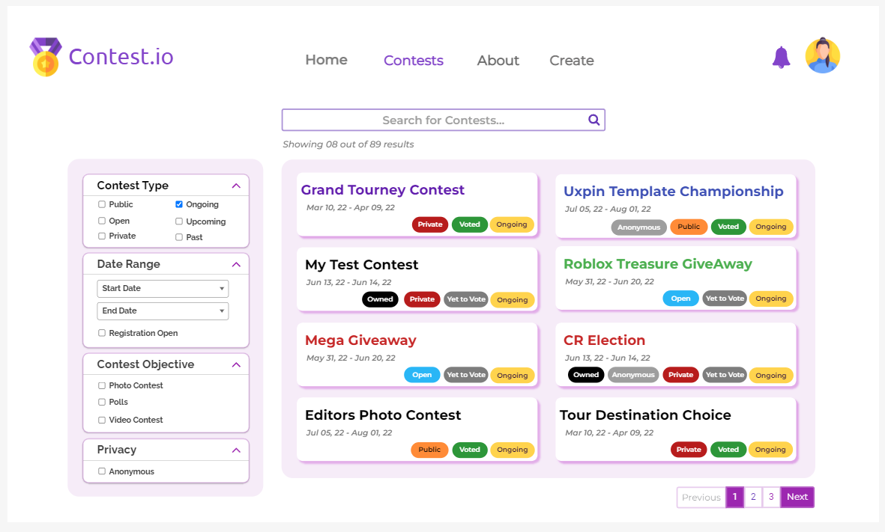
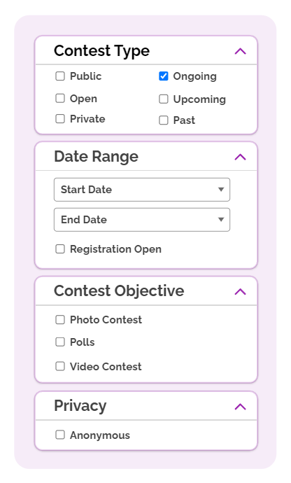
Contests
Search
Search For
Ongoing Contests
Selected Contests

Slide 11
User Profile

Slide 12
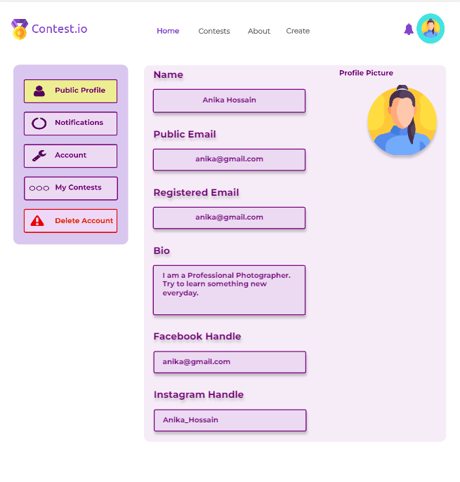
User Profile page of a user
General Details of a User

Slide 13
Notifications

Slide 14
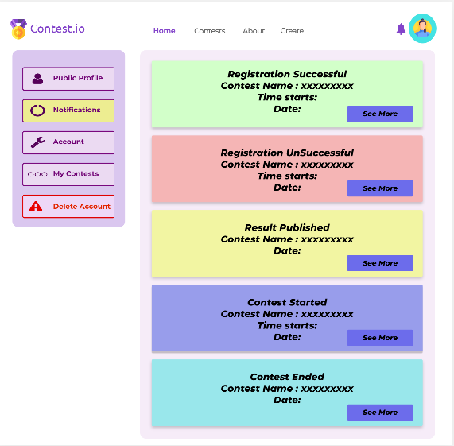
See User Notifications

Slide 15
Account Settings

Slide 16
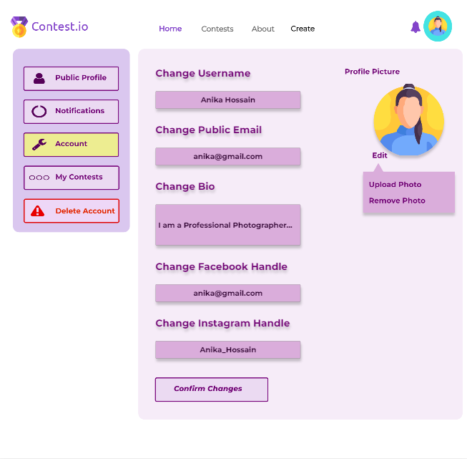
User Account Settings

Slide 17
My Contests

Slide 18
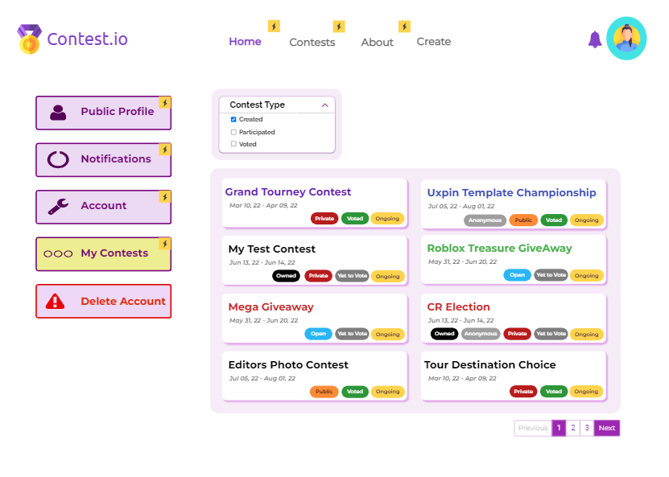
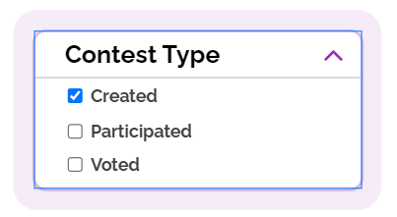
See Created Contests
See User Contests

Slide 19
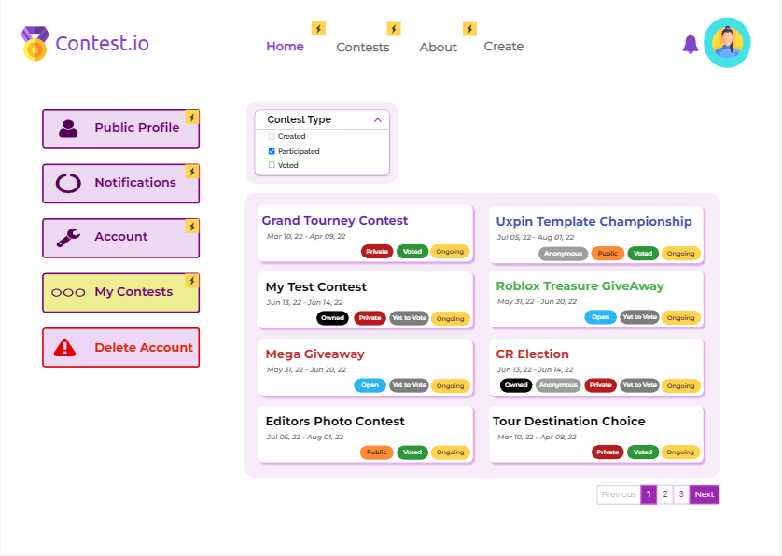
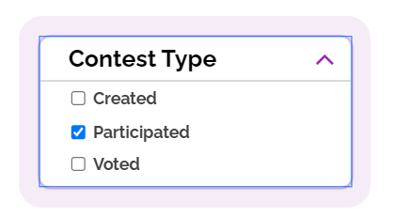
See Participated Contests

Slide 20
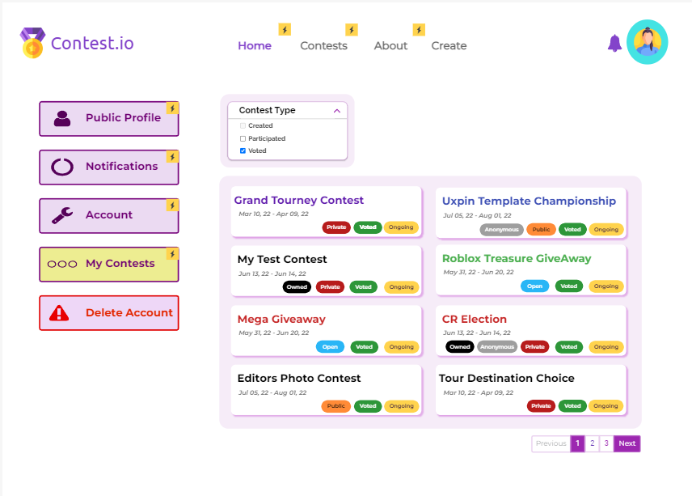
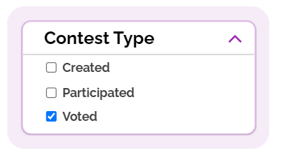
See Voted Contests

Slide 21
Contest Creation

Slide 22
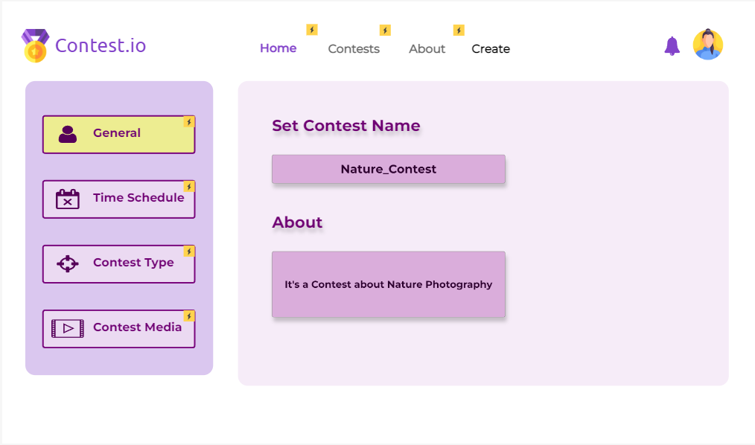
Create
General Settings of a contest

Slide 23
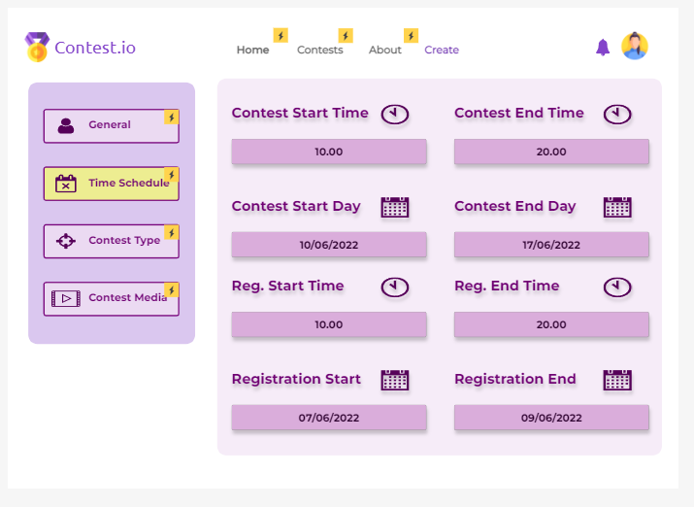
Time related Settings of a contest

Slide 24
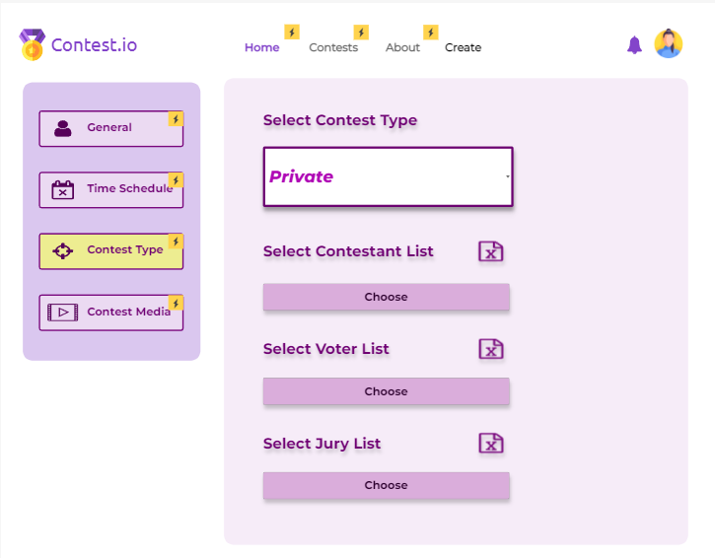
Create
Private Contest
Type Related Settings a contest

Slide 25
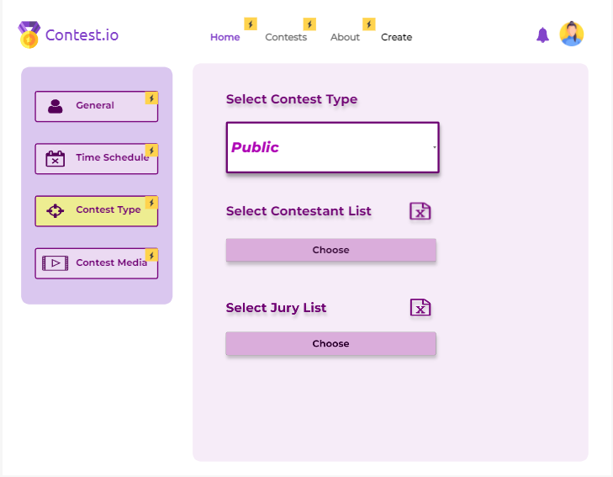
Create
Public Contest

Slide 26
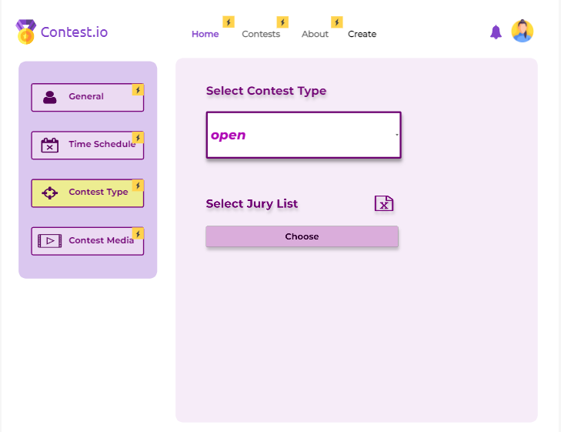
Create
Open Contest

Slide 27
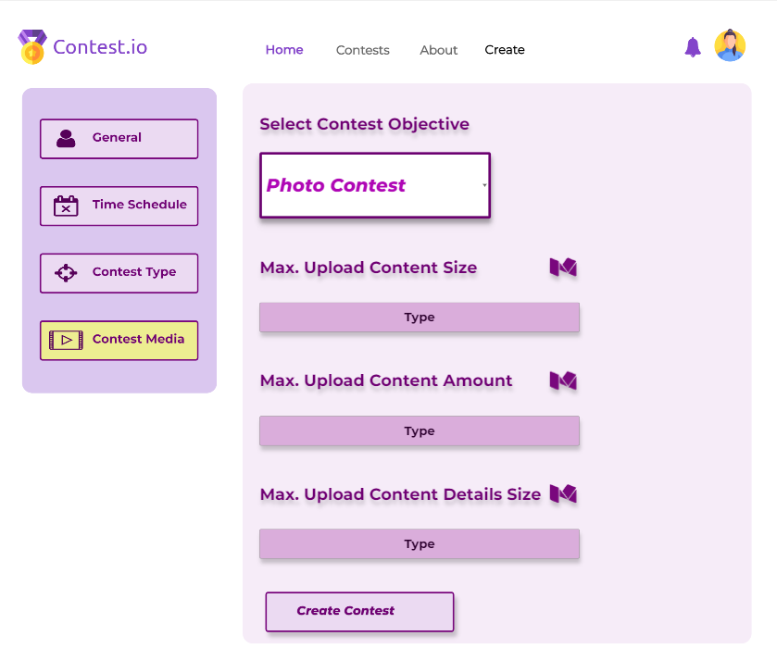
Create
Contest Objective is Photo Contest
Media Related Settings a contest

Slide 28
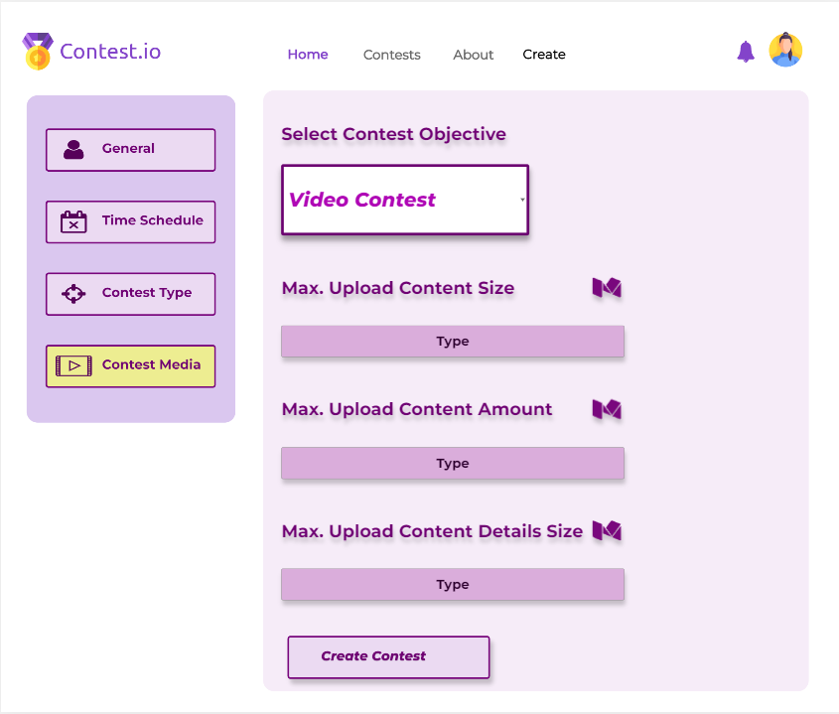
Create
Contest Objective is Video Contest

Slide 29
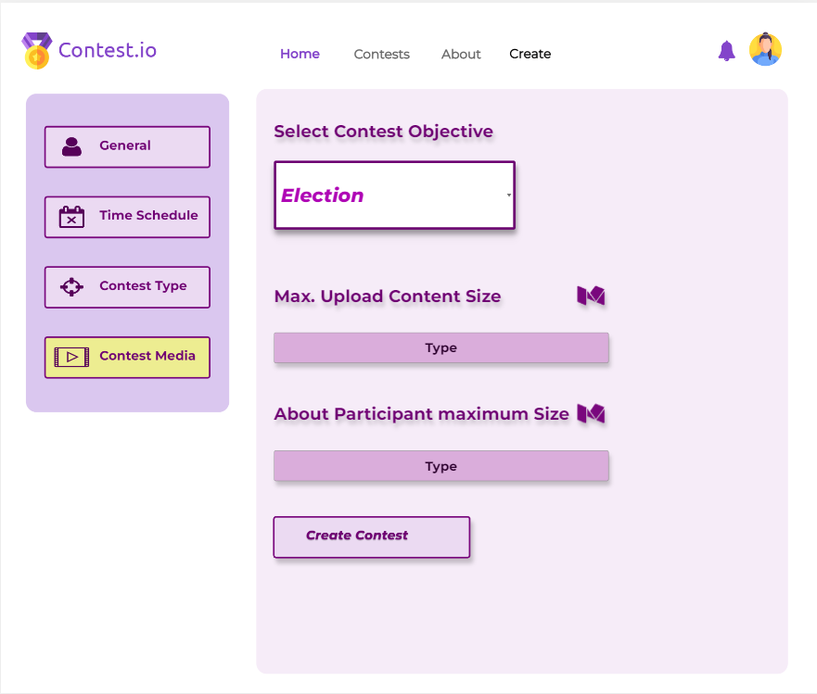
Create
Contest Objective is Election

Slide 30
Contest Info

Slide 31
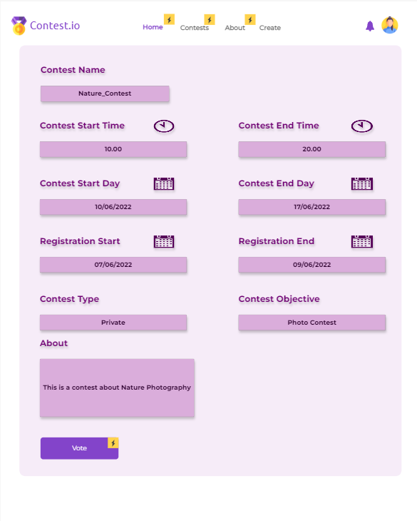
Contests
Voter can go voting menu clicking this button

Slide 32
Voting

Slide 33
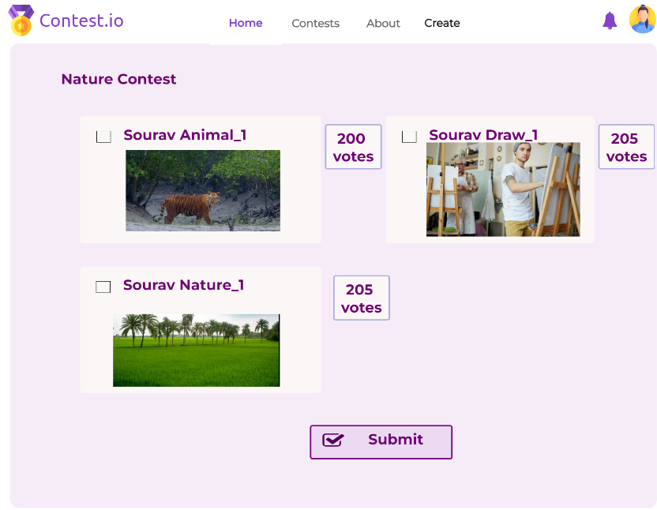
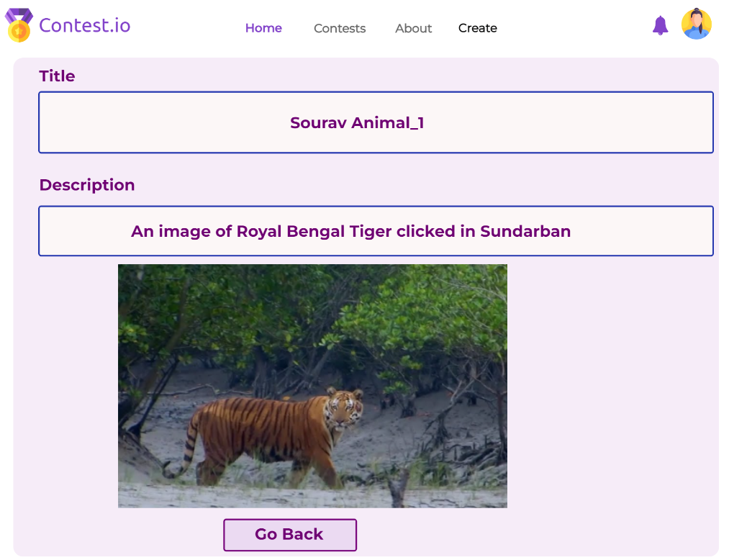
Can See Details Clicking on Title
Select From the Voting Options
Number of received Vote shown.
Confirm Voting

Slide 34
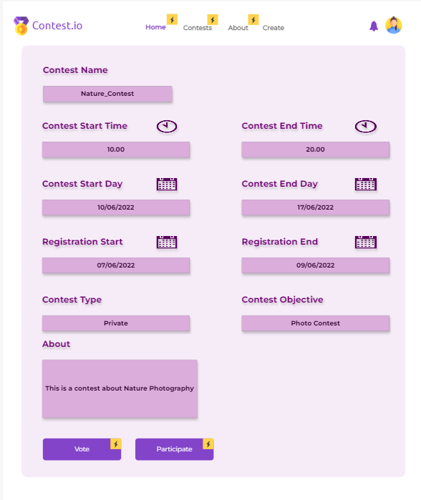
Contests
A participator can go to upload menu clicking this button

Slide 35
Upload Content

Slide 36
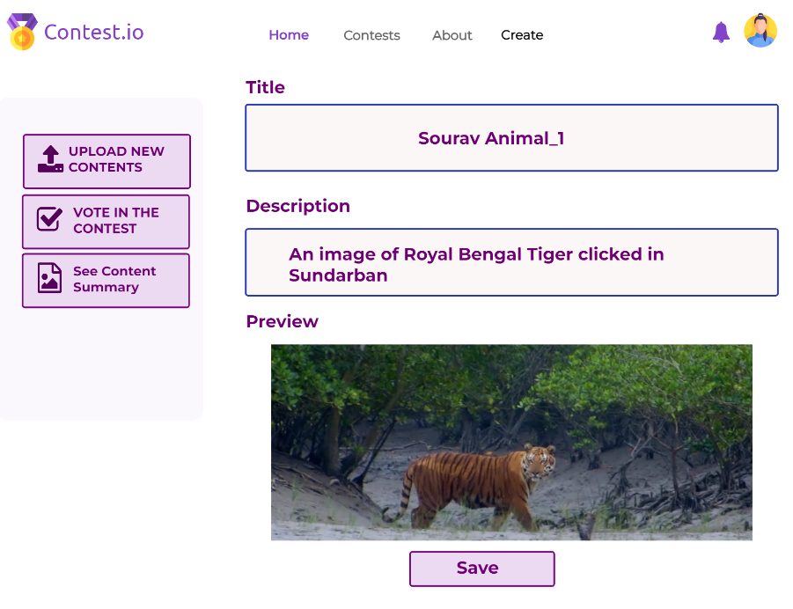
Can edit Title and Description of the content
Will take The Contestant to voting page

Slide 37
Contest Edit
Functionality

Slide 38
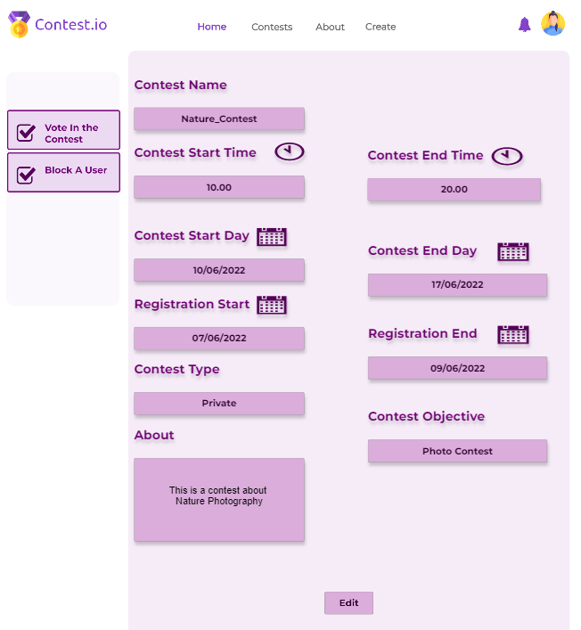

Can Block Any user
Creator can go to edit option clicking this button

Slide 39
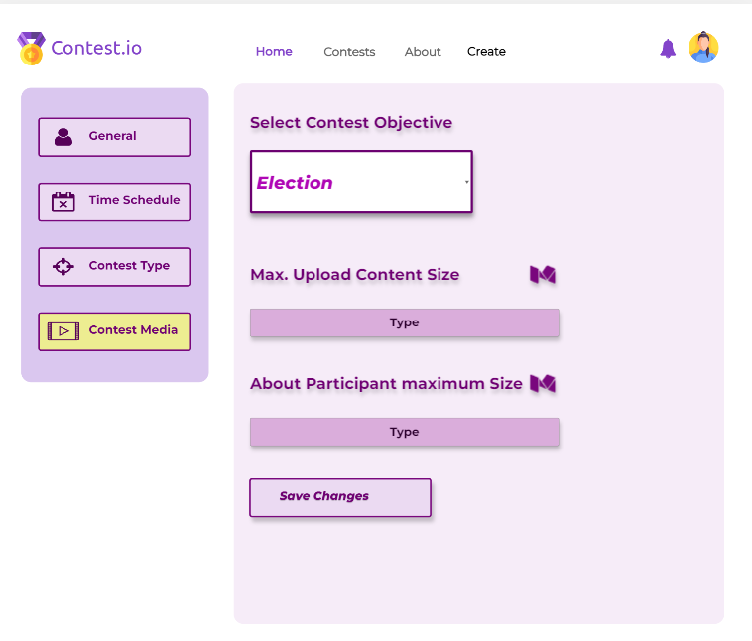
Contests
Create
Save the Changes in a contest

Slide 40
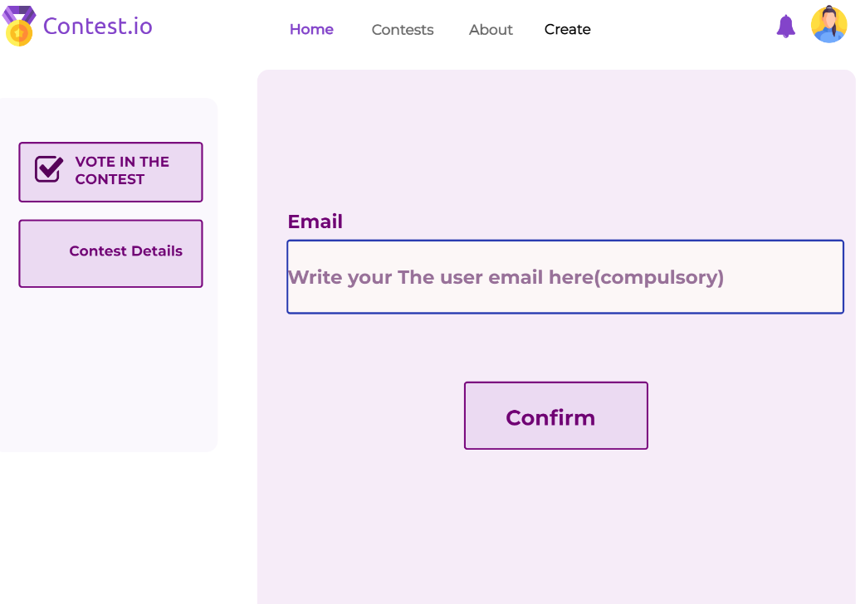
Block Any User Using Their Email

Slide 41
Contestant Content Management

Slide 42
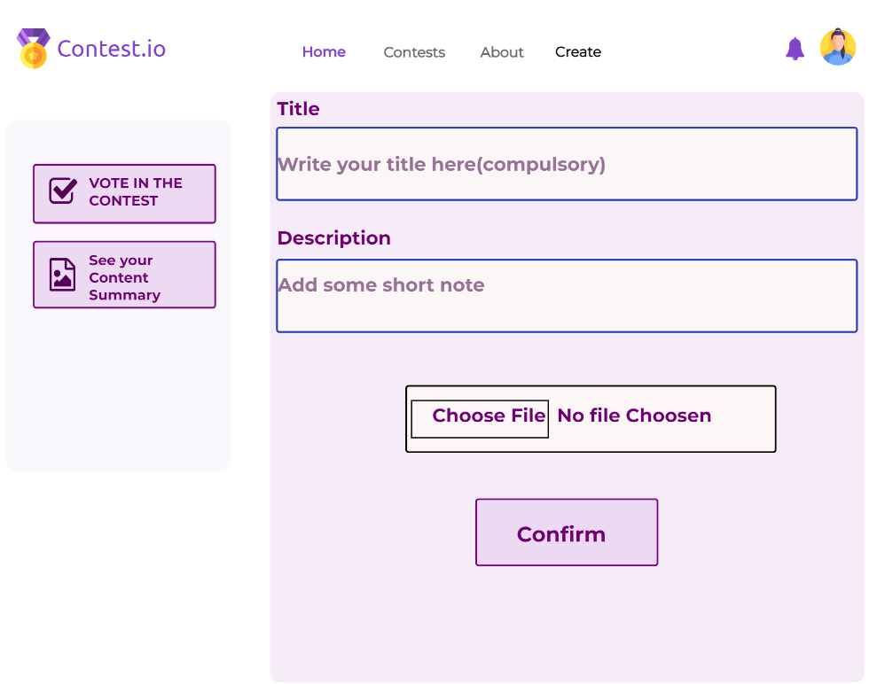
Upload New Content With appropriate Title and Description

Slide 43
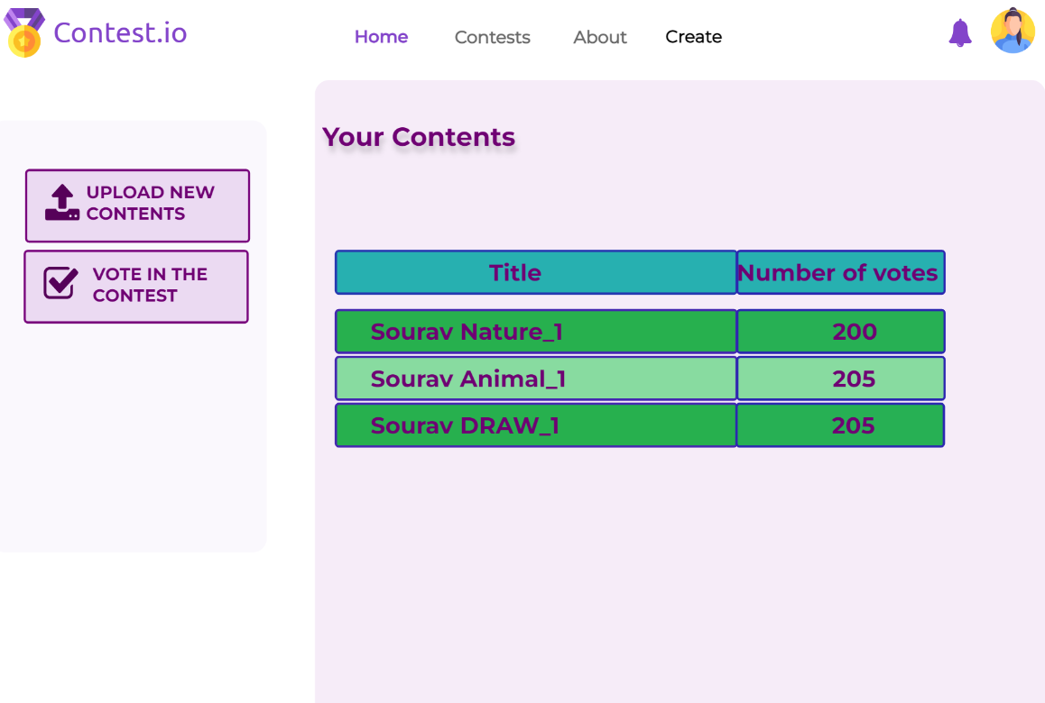
Can edit title and Description after clicking the Title

Slide 44
Results

Slide 45
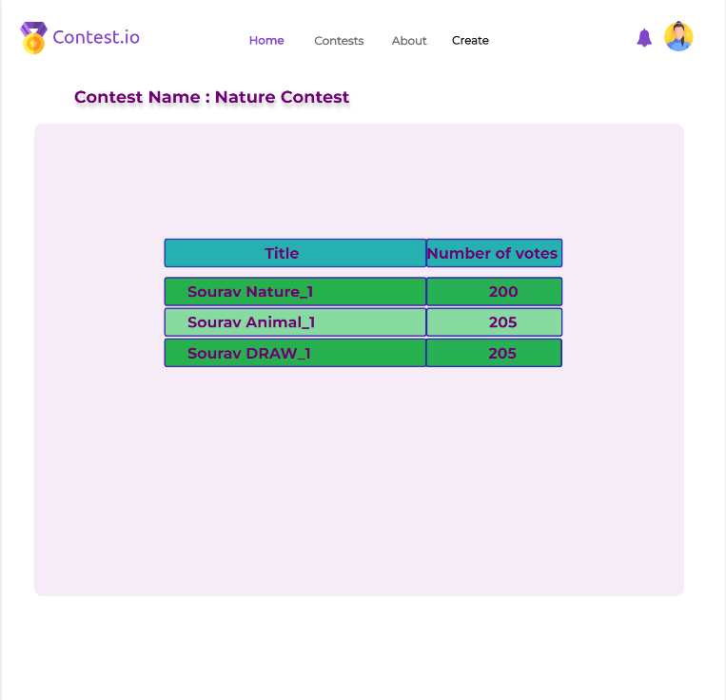
Results of a Contest

Slide 46
Thank You
Any Questions?

